Slide 1
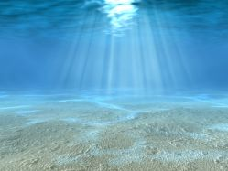
Threats and Dangers to Coral Reefs
Reef IQ

Slide 2
New Vocabulary
New vocabulary will be highlighted in green. Please write down each new word for review at the end of the class.
Notes:
It is a good idea for the students to note down any new vocabulary (highlighted in green) in their books.

Slide 3
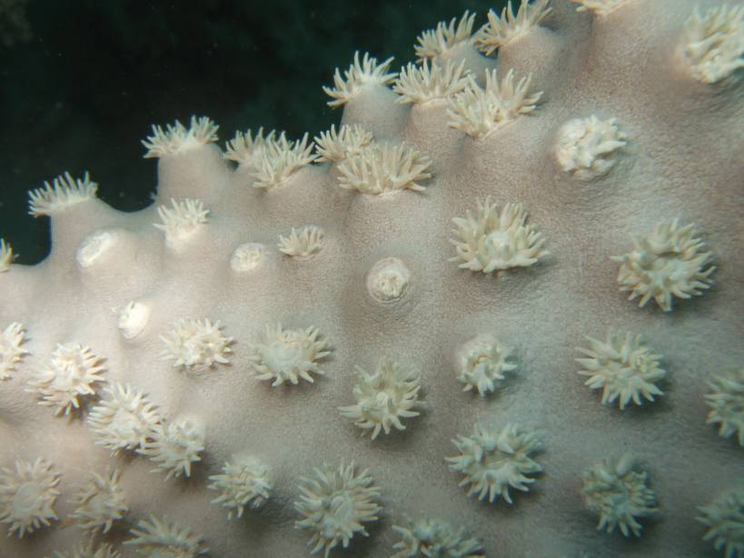
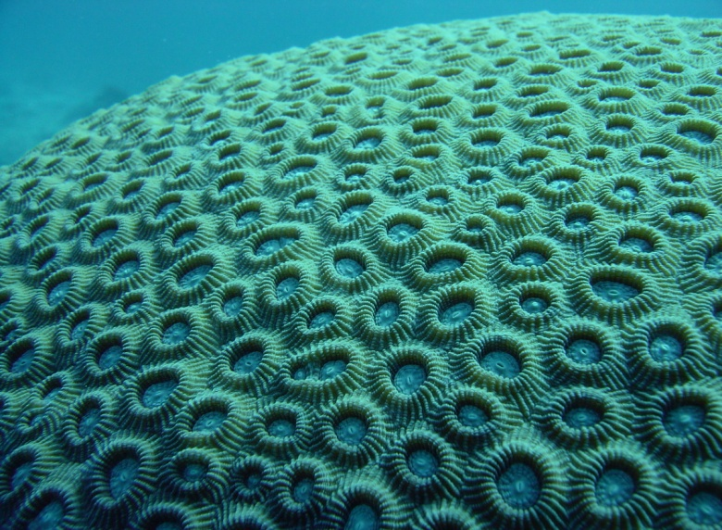
What is a coral?
Each one of these is an individual coral polyp
A plant or an animal?
Coral is an animal!
A single coral animal is called a coral polyp.
The coral polyps live together in colonies to form the vast structures of the reef.
Coral reefs are home to an extraordinary number of marine creatures.
Individual coral polyps
Notes:
It is important that the students understand that corals are an animal and not a plant, and that the coral you see are made up of lots of tiny little animals, called coral polyps.

Slide 4
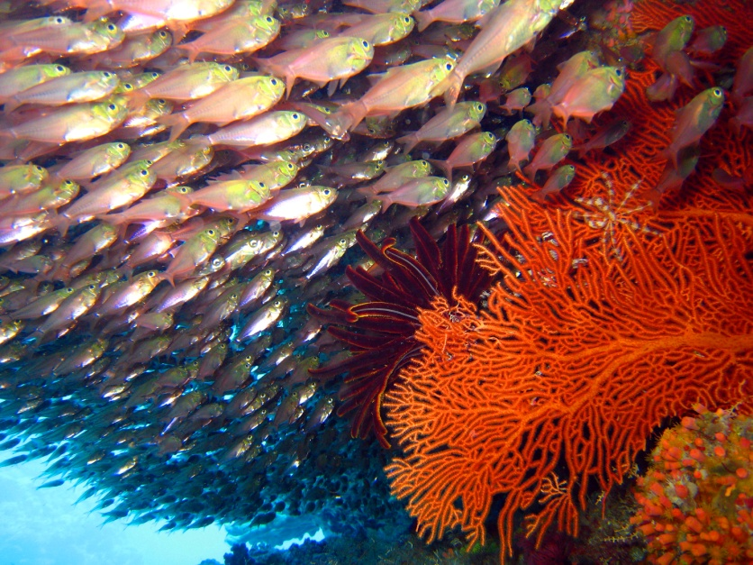
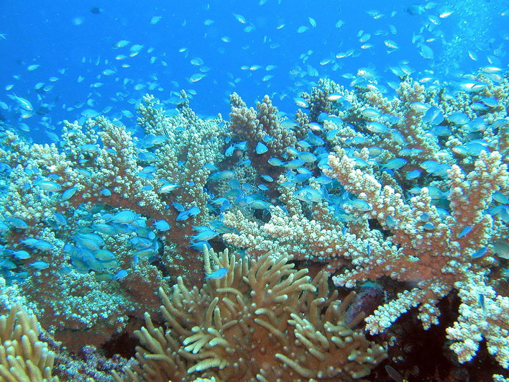
Interesting Coral Reef Facts
The Great Barrier Reef is the largest system in the world and can be seen from outer space. The next largest is the Belize Barrier Reef.
Tropical coral reefs do not grow below 50m. There are however, deep water corals that tend to be stony corals and that grow at great depths in the dark, but little is known about them.
Over 4000 species of fish inhabit tropical coral reefs.
Notes:
Additional Notes:
Some coral reefs are over 100 million years old.
Tropical rainforests have millions of insect species and therefore have the highest biodiversity on earth.
Coral reefs have the highest biodiversity within marine ecosystems with thousands of species of fish alone and over 1000 species of corals.
Coral reefs are the largest living structures visible from outer space (the Great Barrier Reef is over 2000 km long).
Coral reefs worldwide cover an area of 284,300 square km, around 1% of the total area of the world’s oceans.

Slide 5
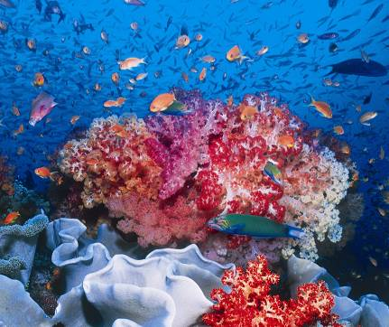
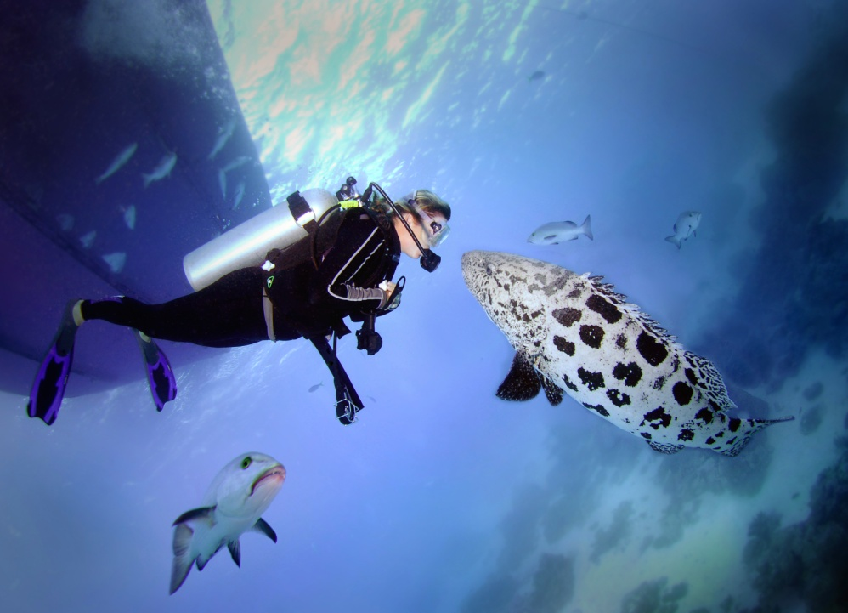
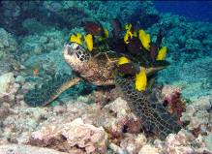
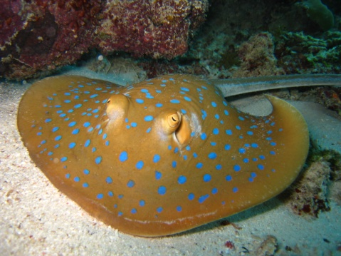
Why are coral reefs important?
Habitat: They are home to 33% of all known fish species.
Nursery: And a nursery ground for over 25% of all marine species.
Photo by MacGillivray Freeman Films
Photo by Dee Wescott
Notes:
Additional Notes:
Some large commercial fish like tuna are often associated with coral reefs in the tropics during their early life stages.

Slide 6
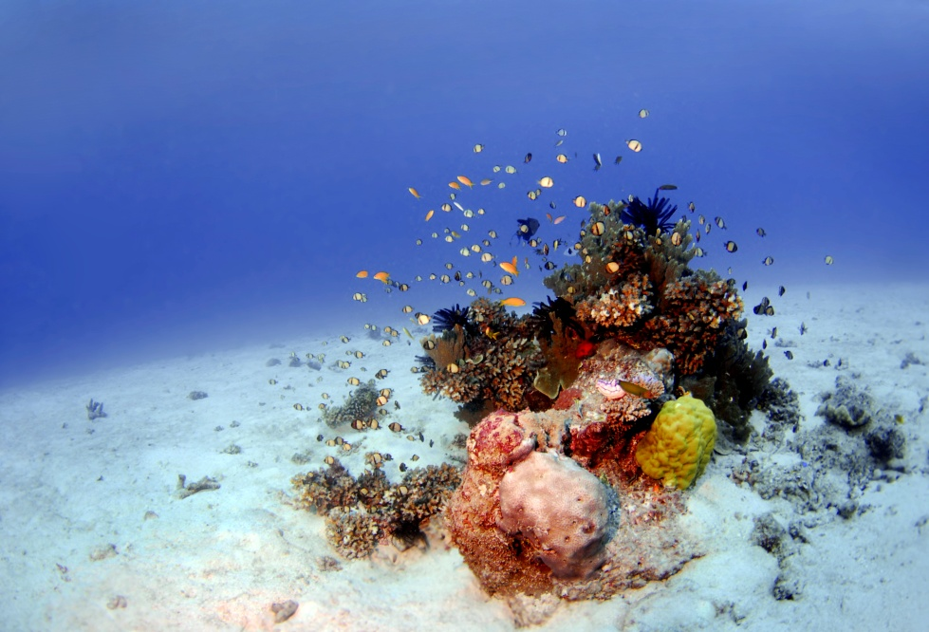
Why are coral reefs important?
Income: they provide millions of dollars of income annually for people living by coral reefs.
Medical Research: coral reefs have the potential to be used as medical cures to treat cancer, heart disease, HIV and arthritis among others.
Protection: they protect 20% of the world’s coast from wave erosion.
Food: they are a food source for millions of people.
Tourism: coral reefs attract tourists from all over the world.
Notes:
Additional Notes:
350 million coastal people rely directly on coral reefs for their food and survival.
Coral skeletons break up into small pieces, and make up the sand of sandy beaches and even islands.
Over 20 million scuba divers visit coral reefs each year.
Tourism is the largest global industry, and coral reefs / tropical islands are one of the main attractions.
The economic potential of coral reef tourism is huge. Current annual revenue is approximately 25 greater than that of fishing. In some areas, a single 2 km stretch of coral reef can bring in US$3 million in revenue compared to $15,000 from destructive fishing.

Slide 7
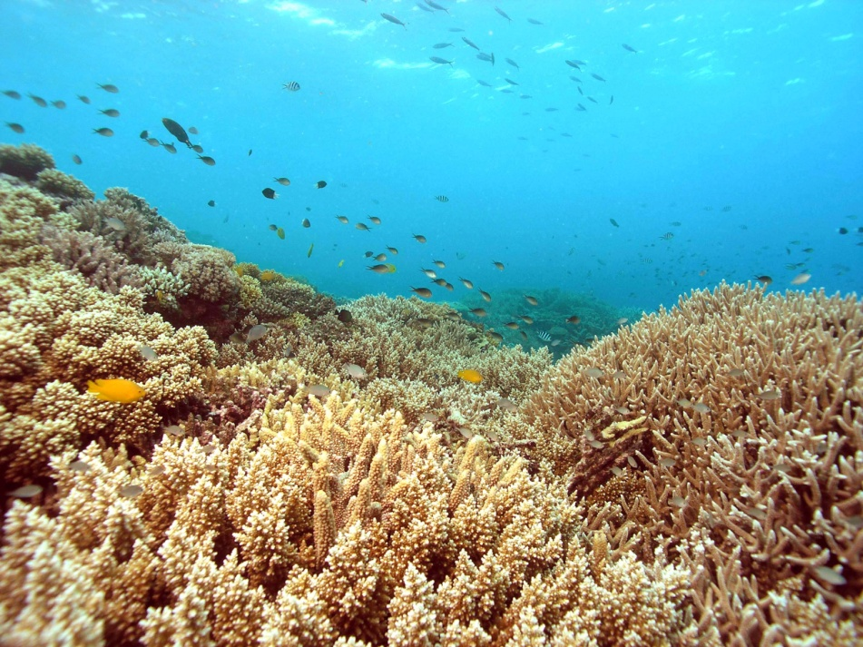
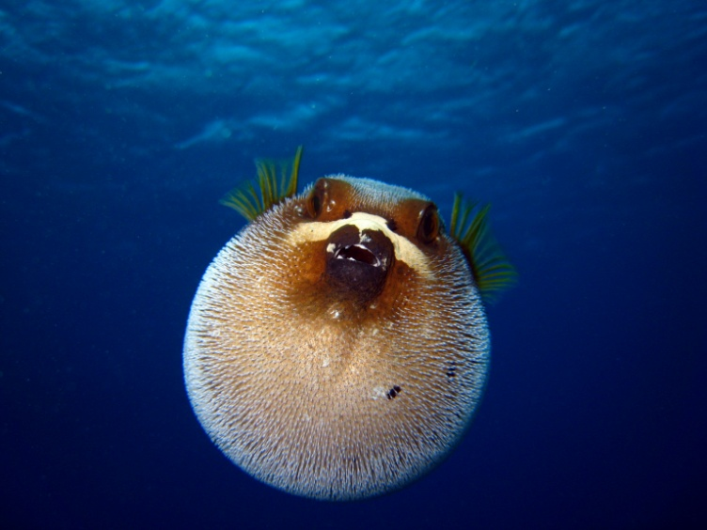
What is a healthy environment for coral reefs?
Sunlight
Water circulation
Low nutrient, clear water
Water temperature 18-29 ºC
A certain salinity
The Great Barrier Reef
A puffer fish puffed up when threatened!
Notes:
Additional Notes:
What are the conditions for coral to grow?
Light: Reef-building corals contain single-celled algae in their tissues called zooxanthellae. The algae live in a symbiotic relationship with the coral (i.e. they are reliant on each other for their mutual survival). The algae provide the coral with food manufactured from photosynthesis and in return the algae receive a safe home as well as nutrients from the waste created by the coral polyp. The zooxanthellae relies on light, therefore these reef-building corals are restricted to the shallow depths of coral reefs, about 60 m or 200 ft.
Low nutrient and clear water: The numerous organisms that inhabit coral reef waters are incredibly efficient at taking up nutrients as soon as they become available from decomposing organisms or dissolved in the water column. Nearly all nutrients are taken up by living organisms leaving the water nutrient poor and clear. Clear water is important to allow light to penetrate to the corals so that the zooxanthellae can photosynthesize.
Salinity: Salinity of between 32 – 42 ppm (parts per million) is optimal for most coral reef organisms. Coral growth is reduced in areas with large freshwater inputs.
Temperature: Optimal temperatures for tropical coral reefs range between 23° and 29°C. Some corals are adapted to survive outside this range. Some reefs have recently been discovered in deep, cold water areas, but these are different to the coral types found in shallow, tropical waters. Excessive temperatures from 33°C upwards (although this varies according to the locality and tolerance of individual corals) can cause the loss of zooxanthellae, bleaching and potentially death.
Water circulation: Waves and currents bring in oxygenated water, prevent sediment deposition and renew the planktonic food supply. Reef development is usually greatest in areas subject to moderate wave action.

Slide 8
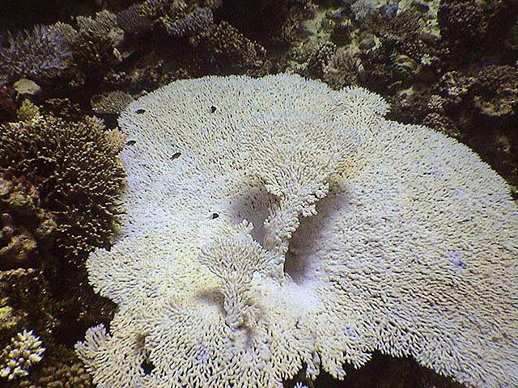
What are the man-made threats to coral reefs?
Global warming leading to coral bleaching.
Runoff of chemicals and nutrients from land
Sedimentation.
Rubbish including marine debris
Overfishing
Physical damage from tourists and fishermen
Pollution from untreated sewage and oil.
An example of coral bleaching.
Notes:
Additional Notes:
The main threat to coral reefs from climate warming is coral bleaching, however there are other threats from climate warming such as ocean acidification and rising sea levels.
Pollution from land activities such as farming and land development increases the nutrient concentration in the water. Elevated nutrient concentrations result in a range of impacts on coral communities, and under extreme situations can result in coral reef community collapse. Elevated nutrient concentrations affect corals by promoting phytoplankton growth, which in turn supports increased numbers of filter feeding organisms such as tubeworms, sponges and bivalves that compete with coral for space. Macroalgal blooms can also result under enhanced nutrient regimes and macroalgae may overgrow coral structures, out-competing coral for space and shading coral colonies to critical levels.
Sedimentation causes problems for the coral by decreasing available light and smothering the coral and other surfaces.
Over fishing removes keystone species from the coral reef ecosystem upsetting the delicate balance.
Unsustainable tourism leads to increasing pollution and damage to the coral.

Slide 9
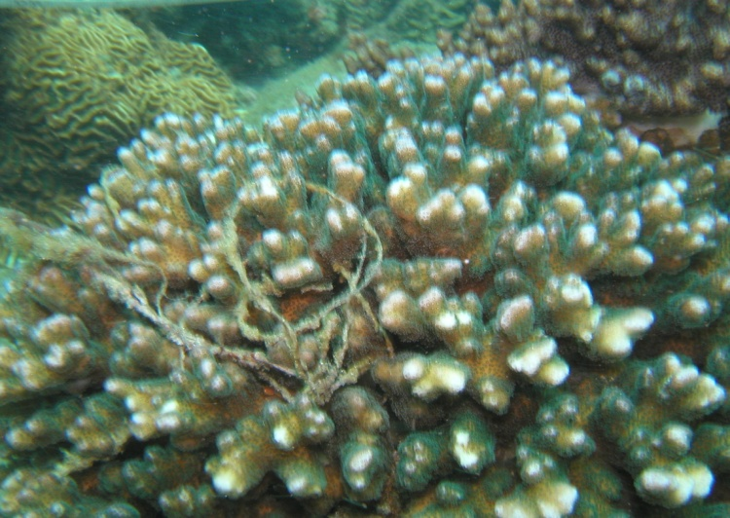
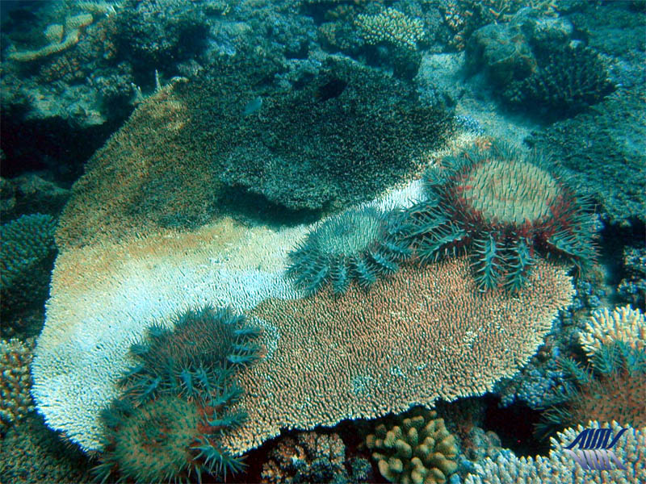
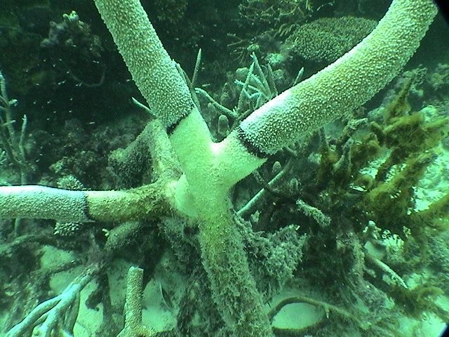
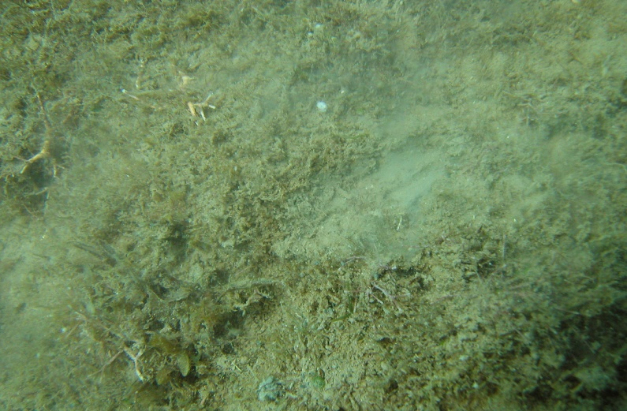
Threats to Coral Reefs
Crown of Thorns Sea Star Outbreak
Fishing Line Trash
Coral Disease (black band)
Sedimentation

Slide 10
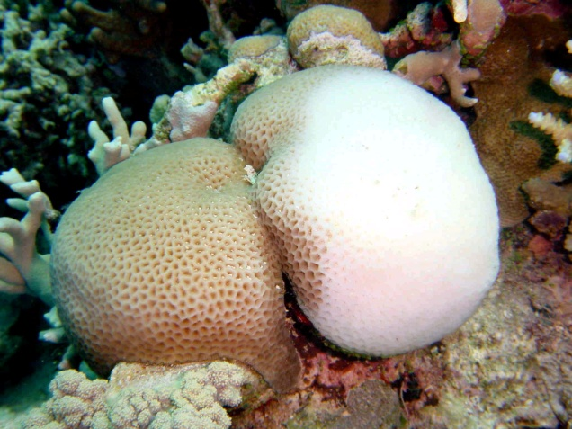
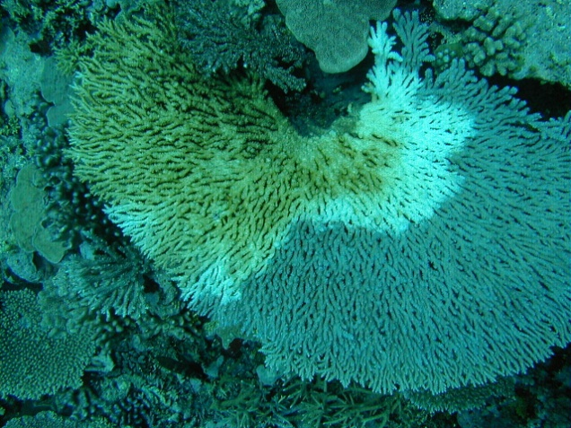
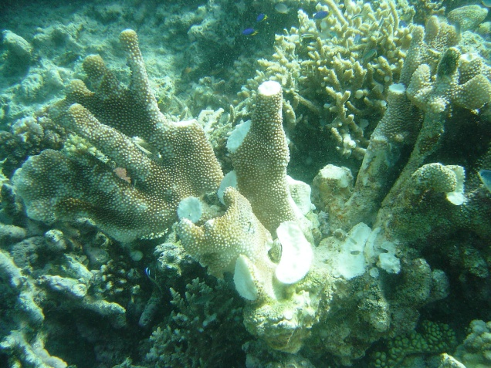
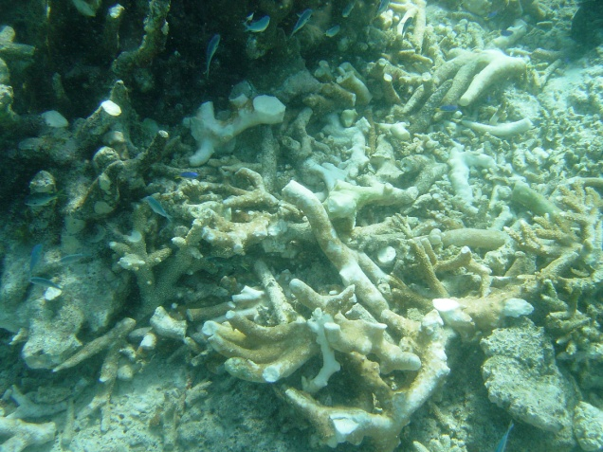
Threats to Coral Reefs
Coral Bleaching
Coral Disease (white band)
Once killed coral turns to rock and rubble
Coral physical damage

Slide 11
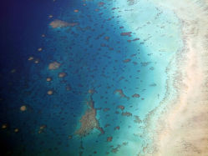
Human Impacts on Coral Reefs
Coral reefs are in serious decline globally: an estimated 30% are already severely damaged, and close to 60% may be lost by 2030.
Until recently, the effects of fishing and pollution from agriculture and coastal development had the most serious negative impacts on coral reefs.
These impacts are now being exacerbated by the effect of climate change, including coral bleaching and the emergence of coral disease.
From Hutchings, P. et al (2008) The Great Barrier Reef: Biology, Environment and Management

Slide 12
Human Impacts on Coral Reefs
The concept of resilience is important to understand; the capacity of coral reefs to cope with natural and human disturbances. Losing resilience means the coral is no longer able to recover from disturbances.
It is important to understand that over time coral reefs have often been disturbed by natural impacts, such as cyclones, but that they often, as has been witnessed, recover from these.
From Hutchings, P. et al (2008) The Great Barrier Reef: Biology, Environment and Management

Slide 13
Human Impacts on Coral Reefs
Unprecedented large scale coral bleaching occurred on the GBR in 1998 and 2002. Coral disease has been steadily increasing over recent years with some scientists putting this down to rising sea temperatures.
Trying to stop damage to reefs is more effective than trying to restore reefs after the damage has been done. Find ways of prevention rather than cure!
From Hutchings, P. et al (2008) The Great Barrier Reef: Biology, Environment and Management

Slide 14
Some of the ways you can help protect coral reefs!
Only eat seafood that comes from sustainable stocks.
Go and visit the coral reefs remembering not to damage any organisms or take anything away.
Help reduce greenhouse emissions by cycling or walking whenever possible rather than taking the car.
Use green bags rather than plastic bags when shopping.
Recycle, recycle, recycle!

Slide 15
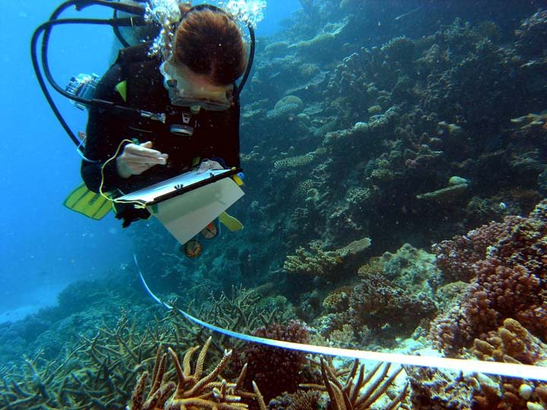
These materials were produced by Reef Check Australia.
THE END!

