Slide 1
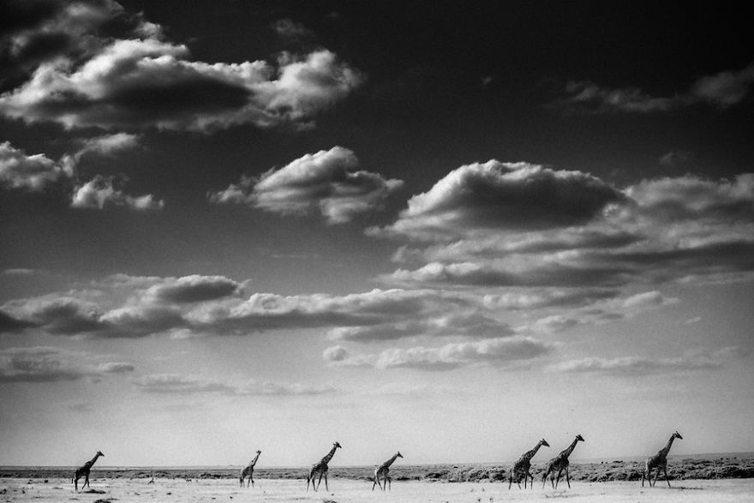
African Trade
Purpose: to Learn the importance of trade throughout Africa and why lack of resources are a main concern

Slide 2
Reflection
Think about the resources we talked about earlier in the unit
gold
water
oil
coffee
Copper
Does everyone have these things?

Slide 3
Instructions
To have a chance to think about what these economic trades would have meant to African people, you will be assigned a role as an ancient African.
Think about what you might buy from the other people, and what you would trade them in return. Who would be further away? Who would be closer?
The card will tell you these things and will also be your guide for the activity.
Arrange yourselves in the room according to your geographical locations.
  (Ex. Egypt up to the right of the projector, South Africa by the white board, etc.)

Slide 4
Your Card
Read through your card carefully..
Bolded words are items you have, Underlined words are items that you want.
IN ADDITION TO THE THINGS ON YOUR CARD YOU WILL ALSO NEED…
  2 food items (any fruit, animal, spice, etc.)
  2 gold
  1 cloth/clothing item (animal fur, linen, cotton)
  2 water
  YOU CANNOT MOVE BEYOND ONE AREA OVER UNLESS YOU ARE A TRADER OR IT SPECIFICALLY SAYS SO ON YOUR CARD.

