Slide 1
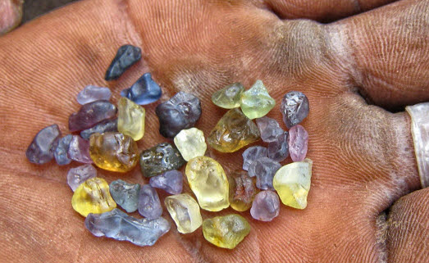
Minerals and resources in Africa
Africa Unit 15-16

Slide 2
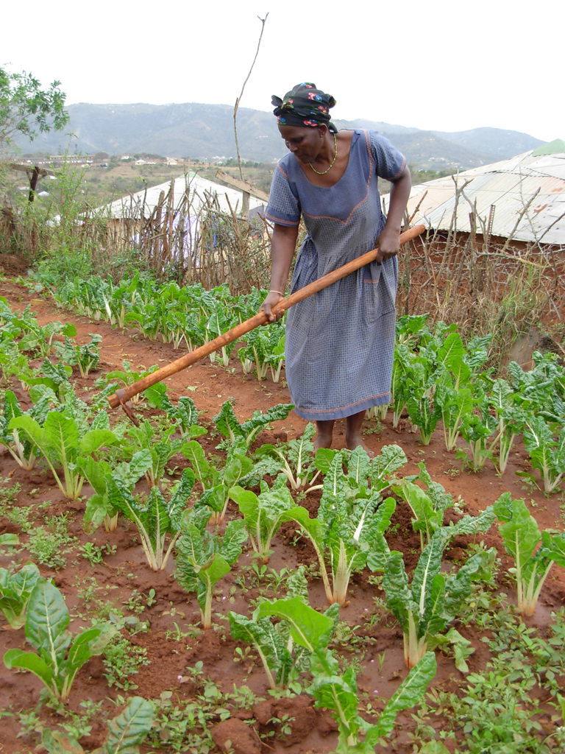
West and Central Africa
Arable Land – land that can be used for farming
Chad’s Agriculture:
3% is arable
Nomadic people
Raise cattle on the savanna
Cotton in the South
Nigeria’s Agriculture:
33% is arable
Cacao is the largest cash crop
Rich in minerals
Huge oil reserves
Other natural resources:
Copper
Diamonds
Uranium
Gold

Slide 3
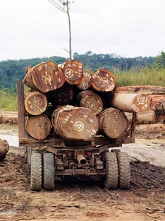
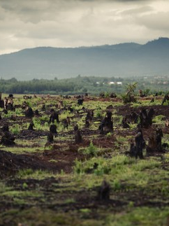
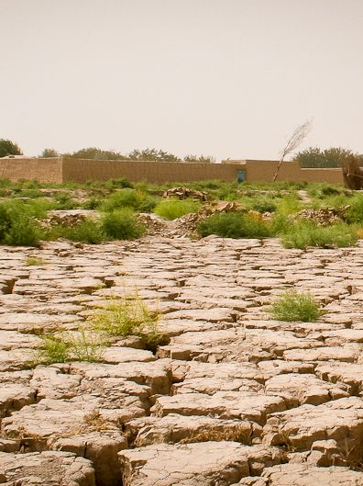
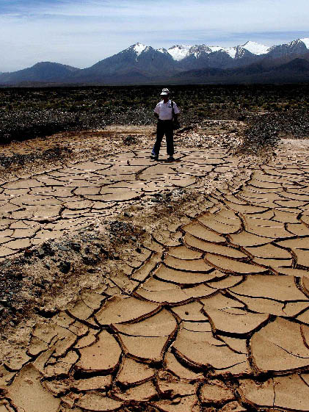
Desertification – the change from arable land to desert caused by:
Herders allowing animals to graze down to the roots of plants, which makes the top soil less compact and leaves behind desert sand.
Chopping down trees for firewood to sell.
Deforestation – loss of forest cover caused by:
Trees being cut down faster than they can grow back
Soil dries out without the shade of trees to protect it from the heat of the sun
  Ex. The Ivory Coast has a very high rate of deforestation – 90% of the forests have been cleared in the last few decades
  Also a problem in the Democratic Republic of the Congo

Slide 4
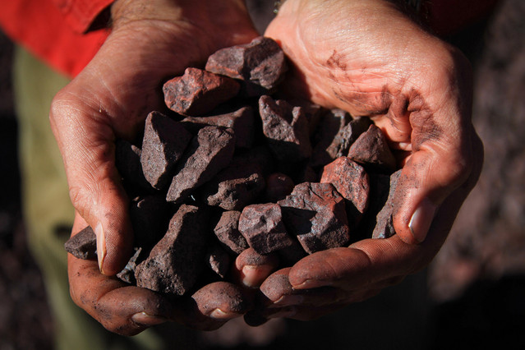
Mining
Metals like diamonds, gold, platinum, copper, tin iron, and uranium
Not all South African countries have similar amounts of minerals
Helps countries build strong economies, brings jobs to local people, yields products to sell around the world.
Miners work long hours in very bad and dangerous conditions
Can also hurt the environment – causes pollution, leaves large scars on the land.
Southern and Eastern Africa
“Southern Africa has more mineral and ore resources than many other parts of the world”
Natural resources:
Coal
Coffee
Diamonds
Oil
Precious Metals
Minerals

Slide 5
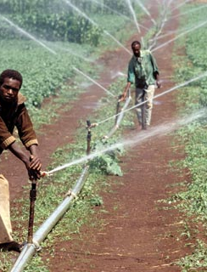
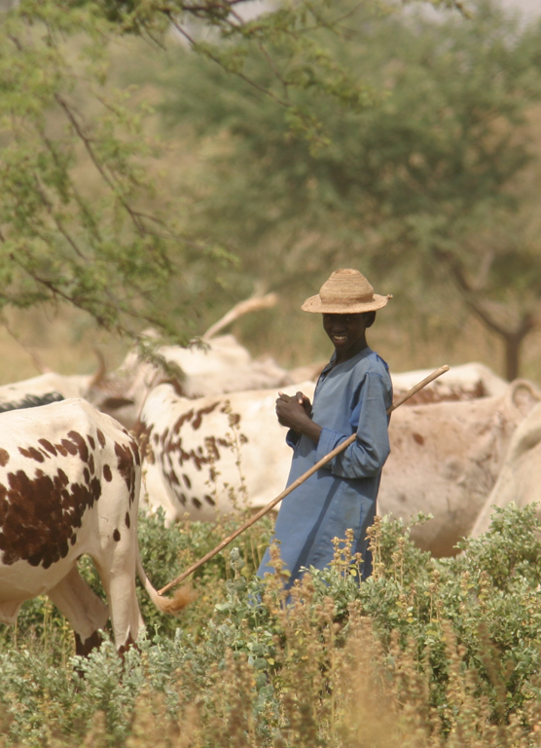
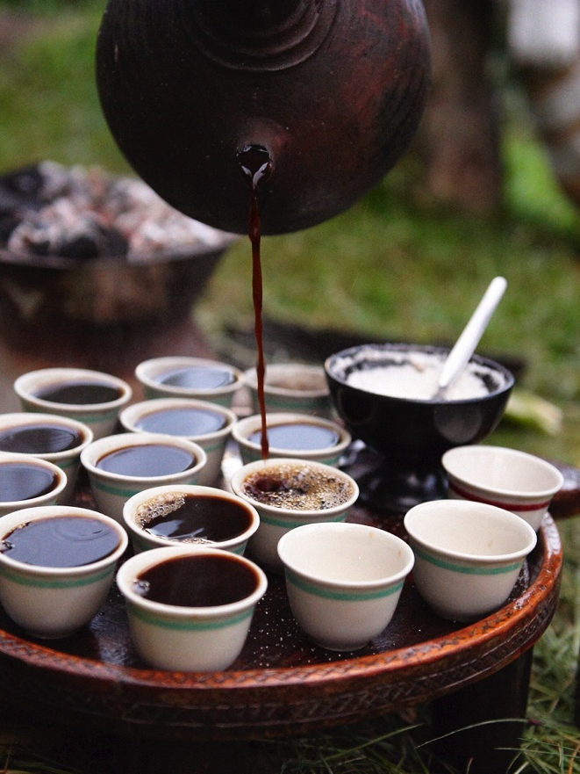
Farming
Most of the countries in the Southern and Eastern region farm
Sudan, Ethiopia, Somalia, and Namibia have little rainfall making it hard to grow crops that need a lot of water
Many farmers irrigate their lands including – cotton, tobacco and tea
Drier areas usually raise cattle and other livestock.
Areas with more rainfall and fertile land grow – sugar cane, avocados, and tropical fruits to export to other countries
Coffee is Ethiopia’s most important export – said to have originated there!

Slide 6
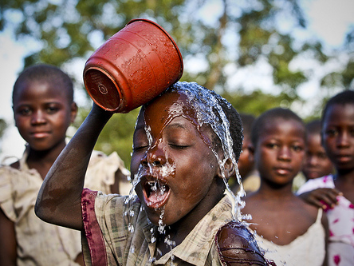
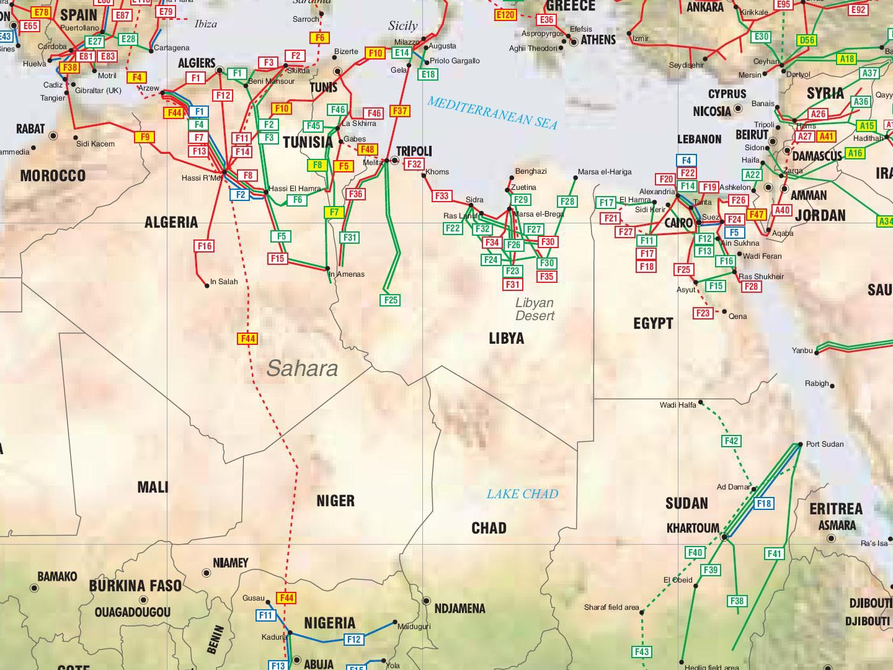
Northern Africa
What are the two most important resources in Africa?
  OIL and WATER
Water
The Nile River in Egypt is a vital source of water for the dry northern region
Farming in the western part of the region and near Egypt include:
Cotton, olives, and citrus fruits
Oil
Every nation in northern Africa has enough oil to use for itself and to export
Most oil is found in the heart of the Sahara
Other resources in this region:
Gas, minerals, and cash crops

Slide 7


