Slide 1
The Land Bridge Theory
Mrs. Reimer
4th Grade Social Studies

Slide 2
Objectives
The students will define what a land bridge is.
The students will describe how the land bridge affected the settlement of Native Americans.
The students will illustrate the movement of Native Americans on a map according to the Land Bridge Theory.
4-2.1
4-2.2
SC 4th Grade Standards

Slide 3

Vocabulary
Talk with your learning team about what you know about these words. Come up with a definition for what you think they might mean.
Land Bridge
Theory
Migrate
Ice Age
Glacier

Slide 4
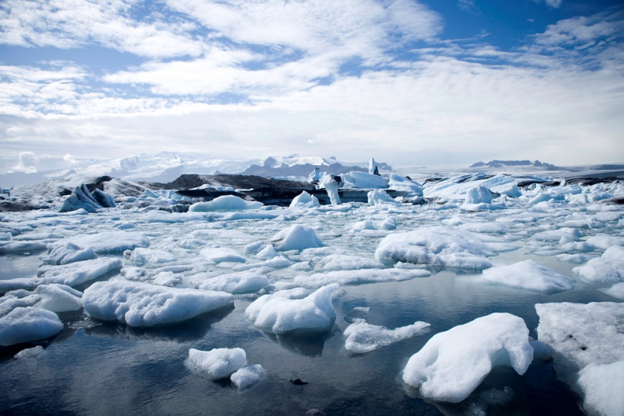
What is the Land Bridge Theory?
According to the Land Bridge Theory, Native Americans migrated from Asia to North America during the Ice Age.
During this time period, very cold temperatures caused large areas on Earth to freeze and form glaciers.
These glaciers caused the level of the water in the ocean to drop.
The land that once was under water became exposed creating a long land bridge that connected North America to Asia.

Slide 5
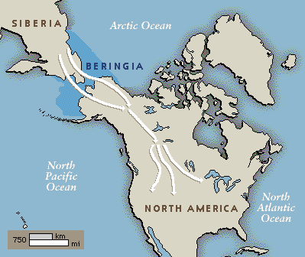
Where was the land bridge formed?
The land bridge was formed between Asia and North America.
This narrow body of water that now separates Asia and North America is called the Bering Strait.
Watch an animation of the Land Bridge Theory here.
Bering Strait

Slide 6
Why did Native Americans follow the land bridge?
Various historians developed the theory that hunter-gatherers may have crossed the land bridge from Asia to North America following herds of animals.
As animals such as the mammoth crossed the land bridge, hunters followed them.

Slide 7
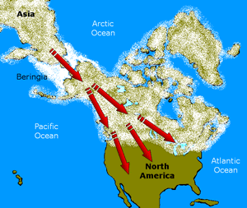
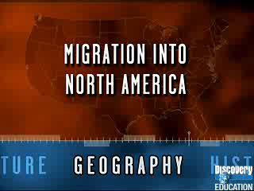
How did the land bridge affect the settlement of Native Americans?
As Native Americans continued to follow and hunt herds of animals, they continued to migrate further South and East.
Watch this video clip to review what we have learned about the Land Bridge Theory.

Slide 8


Show what you know!
A land bridge was formed when ocean levels dropped during the _____________.
The land bridge connected North America and ____________.
The land bridge was formed over the narrow body of water that is now the ___________.
Historians believe that the Native Americans walked across the land bridge in order to _____________.
According to the Land Bridge Theory, Native Americans were travelling both South and __________ to migrate to North America.
Ice Age
Asia
Bering Strait
hunt
East

