Slide 1
Art in Latin america
Latin america unit

Slide 2
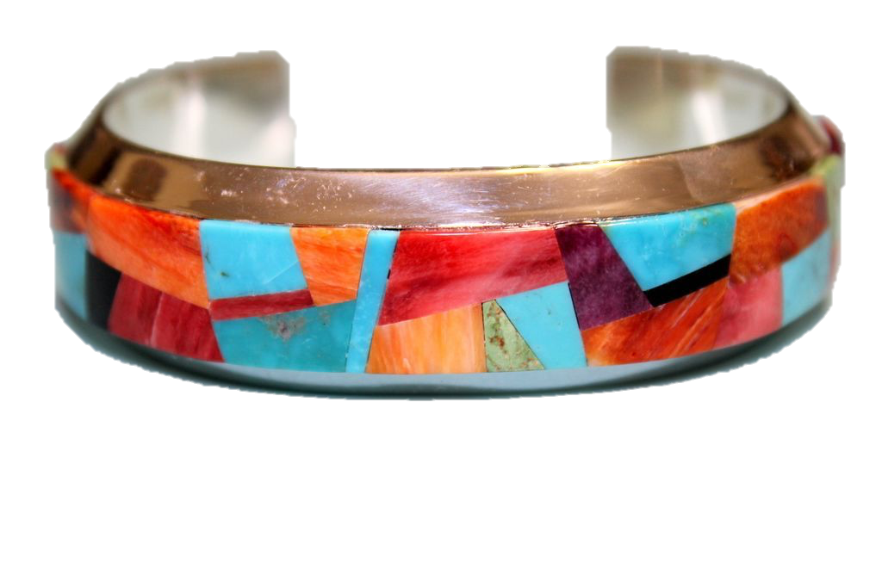
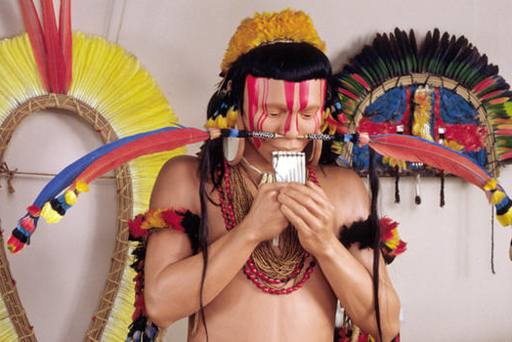
Native art prior to European conquest
Weaving
Pottery
Metalworking
Lapidary
Feather work
Mosaic

Slide 3
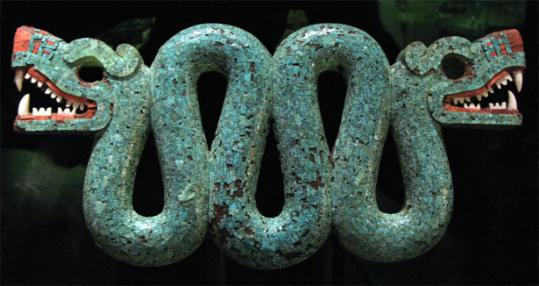
After conquer
Those tribes that were directly contacted by Europeans were taught art by friars
Priests began to create projects that specifically called for the help of indigenous people to be done
Many of these projects were the enormous “houses of worship” within the encomienda system
In the Caribbean, new styles of pottery and glazing were introduced by the Spanish, which soon caught on with the native peoples.
Native artists in this region often adapted their techniques and styles to reflect European trends.

Slide 4
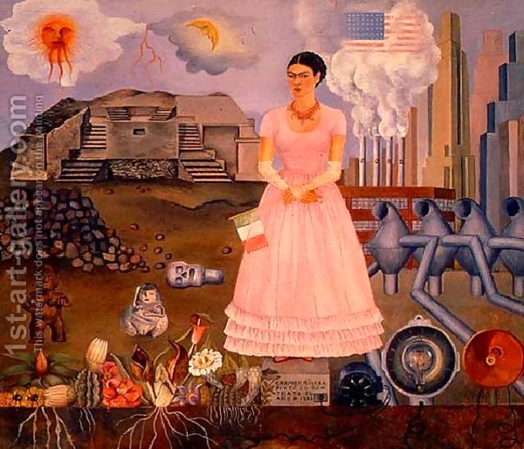
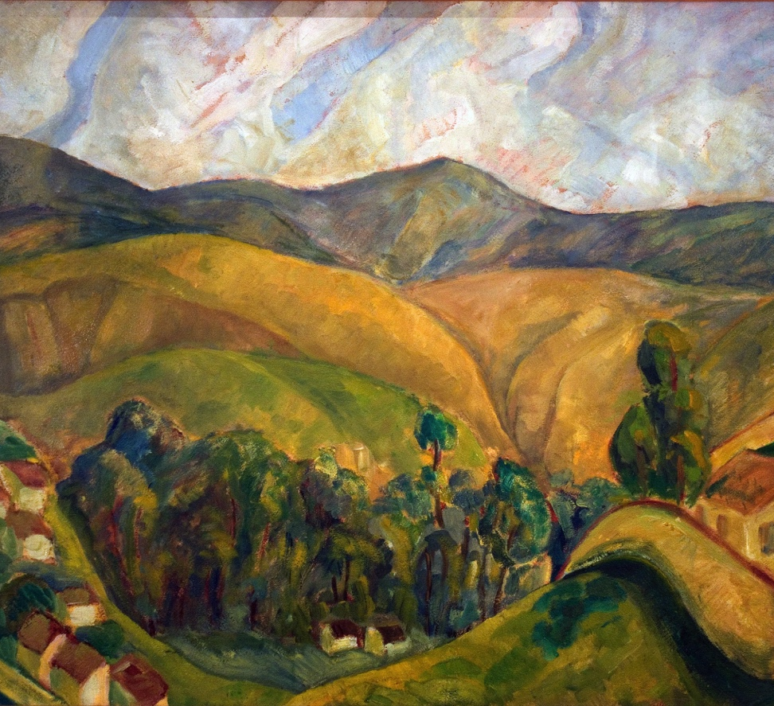
WHO ARE WE TALKING ABOUT?
FRIDA KAHLO
DIEGO RIVERA

Slide 5
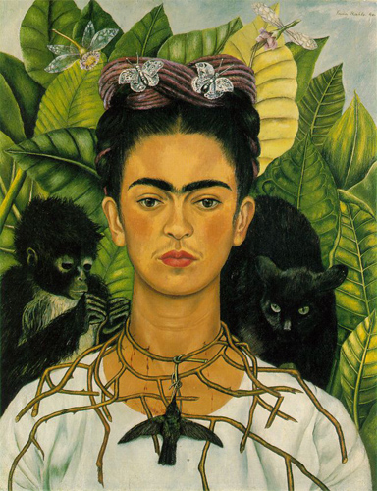
Frida kahlo (1907 – 1954)
Famous Mexican artist
Best known for her surrealist self-portraits
Reflects the emotional and physical pain she endured in her life
These helped her cope with her pain
Frida had a very strong will and often rebelled against things she felt were wrong about society
Married Diego Rivera

Slide 6
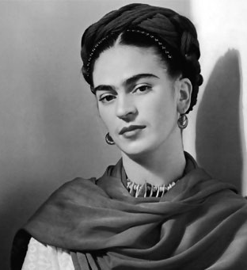
What did she go through?
Grew up during the Mexican Revolution
Bad case of polio, which permanently disfigured her leg
Bus accident that broke her spinal column, collarbone, ribs, pelvis and crushed her right foot
After the accident she could no longer have children

Slide 7
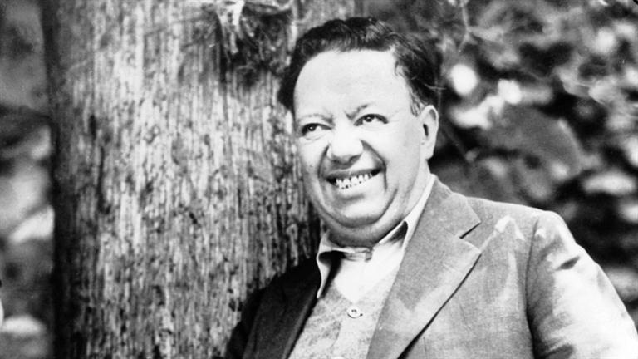
Diego rivera (1886 – 1957)
The painter/Muralist

Slide 8
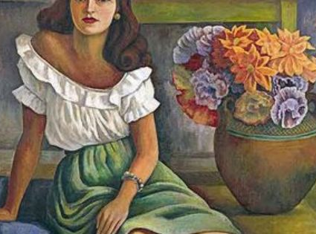
Influence on Latin American culture
Known for his radical political and religious beliefs
Painted scenes that had to do with Mexican society and the Revolution in 1910

