Slide 1



Slide 2
Rules
The room will be split up into two teams.
Every person will get a chance to be the “leader” for at least one round.
You will come to the front of the class to “buzz in”.

Slide 3
Rules
The first leader to buzz in will have ten seconds to answer the question. . If they get it right, their team wins 10 points.
IF they get it wrong, the other team will have 20 seconds to get together with their group and answer the SAME question.
If the team gets it right, they win 5 points. If they get it wrong, the other team has a chance to win.
Once a team earns the points, the next person will approach the front and play starts over again with a new question.
The team with the most points at the end of class wins! (no prizes this time)

Slide 4
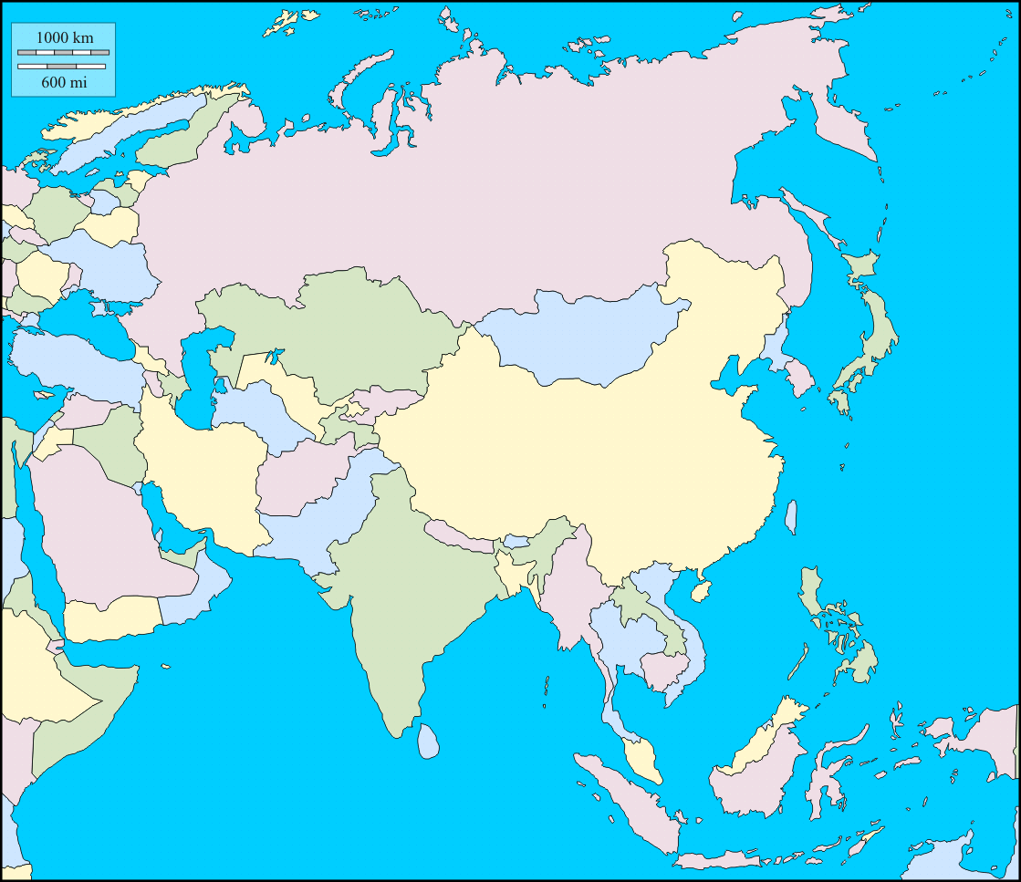
Question
What is the name of this country?

Slide 5
Question
Give the location of one historic landmark.

Slide 6
Question
ISLAM
What term means the “submission to God”?

Slide 7
Question
What is the name of this country?

Slide 8
Question
Genghis Khan
What leader united the Mongol Empire?

Slide 9
Question
Oil and Water
What are the two most important resources in Arabia?

Slide 10
Question
Russian soldiers
Who killed the Romanov family?

Slide 11
Question
What is the name of this country?

Slide 12
Question
Name one advancement or achievement in ancient China.

Slide 13
Question
Haj
Which pillar of Islam requires Muslims to make a pilgrimage to Mecca at least once in their lifetime?

Slide 14
Question
What is the name of this country?

Slide 15
Question
It is less narrative OR told from the point of view of God himself, not from men telling stories.
What is different about the way the Qur’an is written compared to the Torah?

Slide 16
Question
What is the name of this country?

Slide 17
Question
Salat
Which pillar of Islam requires Muslims to pray 5x a day at dawn, noon, afternoon, sunset and evening?

Slide 18
Question
Name one similarity between Muslims and Christians.

Slide 19
Question
Uma
What Islamic term means “community of believers”?

Slide 20
Question
What is the name of this country?

Slide 21
Question
Caliph
What is the name of a political leader in Islam?

Slide 22
Question
Nomadic
What type of lifestyle did the Mongols live?

Slide 23
Question
What is the name of this country?

Slide 24
Question
Explain the importance of one historical landmark.

Slide 25
Question
Name a different advancement from ancient China.

Slide 26
Question
Name one way in which Rasputin was a mysterious person.
^^^Be specific!

Slide 27
Question
What is the name of this country?

Slide 28
Question
They were shot and killed.
What happened when the Romanov family was taken down into the basement of their family home?

Slide 29
Question
Name one similarity between Islam and Sikhism.

Slide 30
Question
What is the name of this country?

Slide 31
Question
Zakat
Which pillar in Islam requires Muslims to give charity to those in need?

Slide 32
Question
Qur’an
What is the name of the holy book that Muslims use to hear the word of God?

Slide 33
Question
What is the name of this country?

Slide 34
Question
Mecca
What is the name of the city that Muhammad established as the center of Islam?

Slide 35
Question
Sharia
What is the name of the body of law that Muslims must follow?

Slide 36
Question
Name one other advancement in ancient China.

Slide 37
Question
7th Century C.E. OR 600s A.D.
Around what time period was Muhammad spreading the word of Allah?

